Slide 1
CSCE 1035 Computer Programming I Chapter 3 Types
University of North Texas

Slide 2

3.1 String Basics

Slide 3

Strings
A string is a sequence of characters
A string literal is a string value that is enclosed with single or double quotes
Python treats both types of quotes the same
You can create a string by assigning a value to the variable or use input() to get the string from the user
Examples
var1 = 'Hello World!'
var2 = "Python Programming"
A string type is a special construct known as a sequence type
A sequence type specifies a collection of objects ordered from left to right

Slide 4
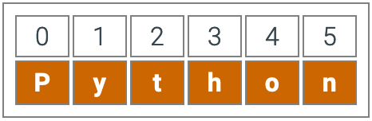
Accessing Values in Strings
Python does not support a character type
Instead, these are treated as strings of length one (also considered to be a substring)
String indices start at 0
Negative indices start at the end of the string and move left
An empty string '' has 0 elements
To access substrings, use the square brackets for slicing along with the index or indices to obtain your substring
A segment of a string is called a slice: varname[start:end]
Examples
var1 = 'Hello World!'
var2 = "Python Programming"
print('var1[0]: ', var1[0])
print("var2[1:5]: ", var2[1:5])

Slide 5
Manipulating Strings
Find the length of the string: len()
Strings are immutable (i.e., read only) in nature
Strings can be updated by an assignment statement with an entirely new string
>>> str = "andrew"
>>> str[0] = "A"
Traceback (most recent call last):
File "<stdin>", line 1, in <module>
TypeError: 'str' object does not support item assignment
>>> str = "A" + str[1:]
>>> print str
Andrew
The + operator is used for string concatenation
Use the * operator to create multiple concatenated copies

Slide 6
3.2 List Basics

Slide 7
Container Types
Containers are built-in data types in Python
Can hold objects of any type (including their own type)
Tuple
An immutable sequence type, holding a collection of objects in a defined order (indexed by integers)
List
A mutable sequence type, holding a collection of objects in a defined order (indexed by integers)
Dictionary
A mapping type, associating keys to values (unordered, indexed by keys)
Set
An unordered collection of unique elements (accessed through set operations)
Each container has its own set of methods

Slide 8
Creating Lists
A list is a sequential collection of values
Each value has a location (i.e., an index)
Values are enclosed in []
my_list = [3, 'a', True]
empty_list = []
Indices range from 0 to n – 1, where n is the length of the list
And from –1 to –n (starting from end of list, moving left)
Lists are heterogeneous
Values can be of any type
Strings are homogeneous since their elements must be characters
Can refer to a list by its name to refer to the list itself or by its elements using []
A list item is called an element

Slide 9
Accessing and Updating Lists
Unlike strings, lists are mutable
Individual elements can be changed the same way any variable can be changed, with an assignment statement
my_list = [1, 9, 'a', 4, 7]
m = 3
my_list[m] = 99
my_list[m + 1] = 'Peter'
Copying mutable sequences
Use [:] to make deep copy of an entire sequence
>>> list2 = list1 # both refer to same ref,
# changing one affects both
>>> list3 = list1[:] # Independent copies, two refs

Slide 10
Adding and Removing List Elements
Use append to add any type of element to right end of list
my_list.append('3')
Can also use + operator, but both operands must be a list
my_list = my_list + ["Joe"]
Use remove to remove an item by value
my_list.remove('Joe')
Use pop to remove an item by index and get its value
my_list.pop(1)
Use clear to remove all items
my_list.clear()

Slide 11
Python Methods and Functions
Function
A function is a block of code to carry out a specific task, contains its own scope (inside the function), and is called by its name
All functions contain zero or more arguments
On exit, a function can or cannot return one or more values
Method
A method behaves like a function, but has a slightly different syntax
A method is always called with a given data value called an object
<object>.<method_name>(<arg-1>, …, <arg-n>)
A method knows about the internal state of the object with which it is called
In Python, all data values are, in fact, objects

Slide 12
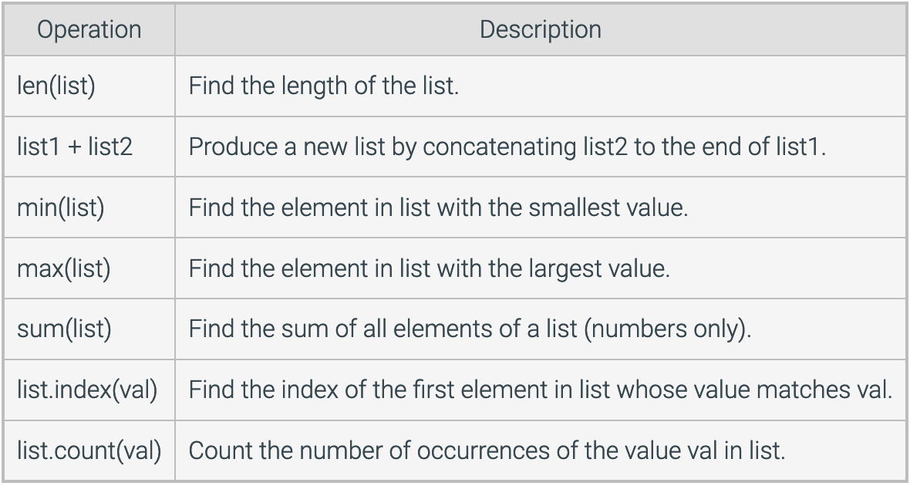
Sequence-Type Methods & Functions

Slide 13
Sequence-Type Methods & Functions
len() is a function on collections that returns the number of items they contain
>>> len(['a', 'b', 'c'])
3
>>> len(('a','b','c'))
3
>>> len("abc")
3
index() is a method on collections that returns the index of the first occurrence of its argument
>>> ['a','b','c'].index('a')
0
>>> ('a','b','c').index('b')
1
>>> "abc".index('c')
2
You will have to learn (and remember or lookup) which operations are functions and which are methods

Slide 14
Tuples
A tuple is another sequence data type that is similar to a list
A tuple is enclosed in parentheses and consists of a number of values separated by commas
If a tuple contains only 1 element, still need to use comma
>>> (1,)
(1,)
Support indexing and other sequence-type functions such as len()
Tuples can be thought of as read-only lists
Examples
tuple = ('abcd', 786, 2.23, 'john', 70.2)
tiny_tuple = (123, 'john')
print(tuple)
print(tuple[2:])
print(tiny_tuple * 2)
Tuples support multiple return values and parallel assignments

Slide 15
Named Tuples
Named tuples support defining a new data type that consists of named attributes
Can be used for any ordinary tuple, and add the ability to get the value by name, but also be index value
The namedtuple package must be imported to create a new named tuple
>>> from collections import namedtuple
>>> Point = namedtuple('Point', ['x', 'y'])
>>> first = Point(1, 2)
>>> second = Point(4, 5)
>>> first.x
1
>>> second[1]
5
>>> print(first)
Point(x=1, y=2)

Slide 16
3.3 Set Basics

Slide 17
Creating Sets
A set is an unordered collection of items
Every element is unique and must be immutable
Set itself, however, is mutable – we can add or remove items from it
A set can contain elements of different types, but not lists
Sets can be used to perform mathematical set operations like union, intersection, symmetric difference, etc.
Passing a list into set() will cause any duplicates to be omitted in the created set
A set is created by placing set literal elements inside curly braces {}, separated by commas, or by using the built-in function set(), that accepts a sequence-type iterable object (e.g., list, tuple, string, etc.)

Slide 18
Adding Elements to a Set
Sets are mutable, but since they are unordered, indexing has no meaning
Cannot access or change an element of set using indexing or slicing
Add a single element using add() method and multiple elements using the update() method
The update() method can accept tuples, lists, strings, or other sets as its argument
In all cases, duplicates are omitted

Slide 19
Removing Elements from a Set
There are three functions (pop, remove, and discard) that remove individual items from a set
pop() removes and returns a random element from the set
remove() removes a specified element from the set
Removing an item that is not in the set causes an error
We can test membership if item exists in set using in operator
>>> my_set = set("apple")
>>> print(my_set)
{'p', 'l', 'a', 'e'}
>>> print('a' in my_set)
True
>>> print('p' not in my_set)
False
discard() removes a specified element from the set, but does not cause an error if the item is not in the set
The clear() function removes all elements from the set

Slide 20


Set Operations
Sets can be used to perform all the standard mathematical set operations using operators or methods
The union ( | ) is the merger of two sets
>>> s1 = set([4, 6, 9])
>>> s2 = set([1, 6, 8])
>>> s1.union(s2)
{1, 4, 6, 8, 9}
>>> s1 | s2
{1, 4, 6, 8, 9}
Any element that is in both sets will appear in their intersection ( & )
>>> s1 = set([4, 6, 9])
>>> s2 = set([1, 6, 8])
>>> s1.intersection(s2)
{6}
>>> s1 & s2
{6}

Slide 21


Set Operations (cont’d)
Python can also find the set difference ( – ) between two sets, which is the set of elements that are in the first set, but not the second
>>> s1 = set([4, 6, 9])
>>> s2 = set([1, 6, 8])
>>> s1.difference(s2)
{9, 4}
>>> s1 - s2
{9, 4}
The symmetric difference ( ^ ) of two sets is the set of elements that are in one of either set, but not in both
>>> s1 = set([4, 6, 9])
>>> s2 = set([1, 6, 8])
>>> s1.symmetric_difference(s2)
{1, 4, 8, 9}
>>> s1 ^ s2
{1, 4, 8, 9}

Slide 22
Multiple Sets
Starting in Python 2.6, union, intersection, and difference set operations can work with multiple inputs by using the set() constructor
>>> s1 = set([3, 6, 7, 9])
>>> s2 = set([6, 7, 9, 10])
>>> s3 = set([7, 9, 10, 11])
>>> set.union(s1, s2, s3)
{3, 6, 7, 9, 10, 11}
>>> set.intersection(s1, s2, s3)
{9, 7}
>>> set.difference(s1, s2, s3)
{3}
>>> set.difference(s3, s2, s1)
{11}

Slide 23
3.4 Dictionary Basics

Slide 24
Creating a Dictionary
A dictionary is a container used to describe associative relationships
It is a built-in data type for non-sequential collections
Dictionaries are a hash-table type for fast lookup
Python dictionaries are mappings: key : value pairs
A key is unique and acts as an index to find the associated value
Keys can be any immutable type, such as a number, string, or tuple but are usually numbers or strings
A value describes some data associated with a key, such as a definition
Values can be any arbitrary Python object (i.e., anything)
A dictionary can be created by listing key-value pairs inside curly braces {}
An empty dictionary consists of {}

Slide 25
Working with Dictionary Entries
We can access the value associated with a particular key using square brackets []
If no entry with a matching key exists, a runtime error occurs
Dictionaries are mutable
You can extend a dictionary by adding new entries
If already exists, will replace existing entry
passwd['newuser'] = '123456'
A common method for building dictionaries is to start with an empty collection and add key-value pairs one at a time
passwd = {}
for line in open('passwords', 'r').readlines():
user, pass = string.split(line)
passwd[user] = pass
More later on this topic!

Slide 26
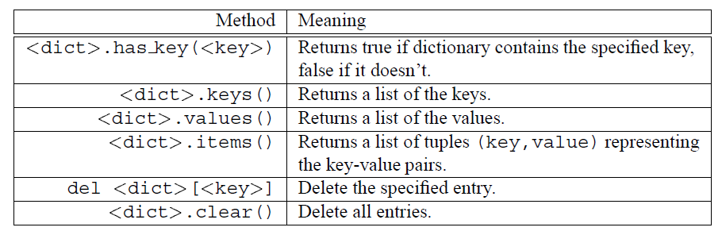
Working with Dictionary Entries
The del() method deletes an element from a dictionary
del passwd['Root']
There are other operations available on dictionaries (in addition to those mentioned here)
deprecated, use in operator

Slide 27
3.5 Common Data Types Summary

Slide 28
Python Data Types
Python’s built-in data types are grouped into several classes
None Type
Represents a null variable or object
Comparing None to anything will always return False, except None itself
a = None
Boolean Type
Built-in values True and False, mostly interchangeable with the integers 1 and 0, respectively
Useful in conditional expressions
>>> 10 < 20
True
>>> a = 5 > 10
>>> print(a)
False
>>> print(True + True)
2

Slide 29
Python Data Types (cont’d)
Numeric Type
int
float (also scientific notation)
complex, written in the form a + bj or a + bJ
a = -1 + 4.4j
bin, prefixed with 0b or 0B
a = 0b01000001
oct, prefixed with 0o or 0O
a = 0o134
hex, prefixed with 0x or 0X
a = 0x17ab

Slide 30
Python Data Types (cont’d)
Sequence Type
str represents the string data type, enclosed in single or double quotation marks
list is a positionally ordered collection of arbitrarily typed objects with no fixed size that are mutable
tuple is a sequence of immutable objects (i.e., a read-only list)
Mapping Type
A mapping object maps hashable values to arbitrary objects
Mappings are mutable objects
There is currently only one standard mapping type, dict, consisting of pairs (called items) of keys and their corresponding values

Slide 31
Python Data Types (cont’d)
Set Type
set is an unordered collection of elements that does not accept duplicate items
Elements may not appear in the same order as they are entered into the set
frozenset is similar to that of a set, but cannot modify any item
>>> s = {3, 2, 4, 1}
>>> print(s)
{1, 2, 3, 4}
>>> fs = frozenset(s)
>>> print(fs)
frozenset({1, 2, 3, 4})

Slide 32
3.7 Type Conversions

Slide 33
Type Conversion
Data can sometimes be converted from one type to another
E.g., the string "3.0" is equivalent to the floating-point number 3.0, which is equivalent to the integer 3
Sometimes this is done implicitly by the interpreter
>>> print(type(1 + 2.0))
<class 'float'>
Functions exist that will take data in one type and return the data in another type
int() converts compatible data into an integer
float() converts compatible data into a floating-point number
str() converts compatible data into a string
...

Slide 34
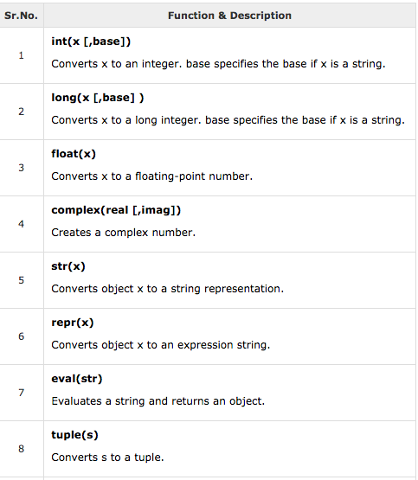
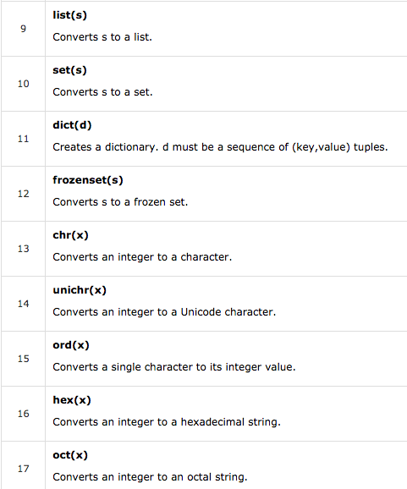
Type Conversion Functions

Slide 35
Type Conversion
Examples
int(3.3) produces 3
str(3.3) produces "3.3"
float("3.5") produces 3.5
float(3) produces 3.0
int("7") produces 7
int("7.1") throws an ERROR
float("Test") throws an ERROR
>>> int(15.56)
15
>>> complex(5, 1)
(5+1j)
>>> str1 = "1c2"
>>> n = int(str1, 16)
>>> print(n)
450
You can determine the data type of a variable using the type() function

Slide 36
3.8 Binary Numbers

Slide 37
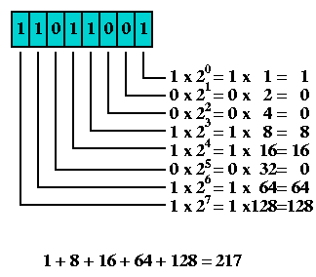
Binary-to-Decimal
The powers of 2 (binary) give us the decimal weights
This means that 11011001 is 217 in decimal

Slide 38
Decimal-to-Binary
Continually divide the decimal number by 2 until you get 0 as the quotient and then collect the remainders
Then read the binary numbers in opposite order of collection of the remainders
Remember, the remainders can only be 0 or 1
Division Operation | Quotient | Remainder
217/2 | 108 | 1
108/2 | 54 | 0
54/2 | 27 | 0
27/2 | 13 | 1
13/2 | 6 | 1
6/2 | 3 | 0
3/2 | 1 | 1
1/2 | 0 | 1
This means that 217 is 11011001 in binary

Slide 39
Hexadecimal
decimal | binary | hexadecimal
0 | 0000 | 0
1 | 0001 | 1
2 | 0010 | 2
3 | 0011 | 3
4 | 0100 | 4
5 | 0101 | 5
6 | 0110 | 6
7 | 0111 | 7
8 | 1000 | 8
9 | 1001 | 9
10 | 1010 | A
11 | 1011 | B
12 | 1100 | C
13 | 1101 | D
14 | 1110 | E
15 | 1111 | F
Hexadecimal is base 16
Uses 16 digits
Why use Hex?
Binary numbers are too long
Example
What’s 0x2BAD in binary?
What’s 0x2BAD in decimal?
0 1 2 3 4 5 6 7
8 9 A B C D E F

Slide 40
3.9 String Formatting

Slide 41
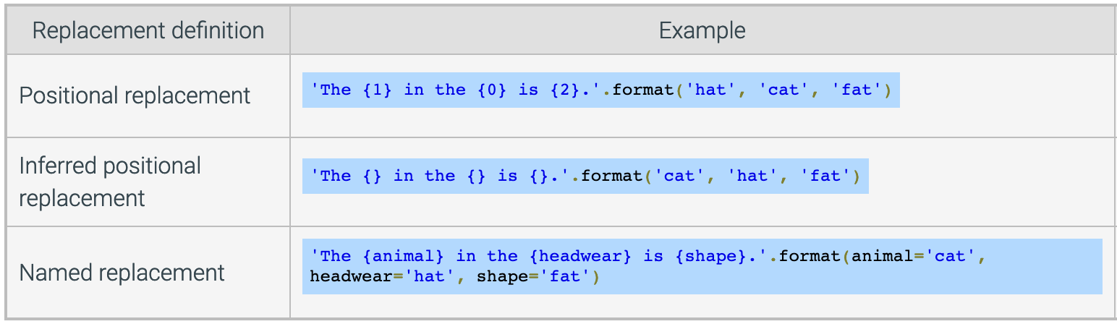
String Formatting
The string format() method allows you to create a string with placeholders that are replaced by values or variable values at execution
A placeholder surrounded by curly braces {} is called a replacement field
Three ways to format strings

Slide 42
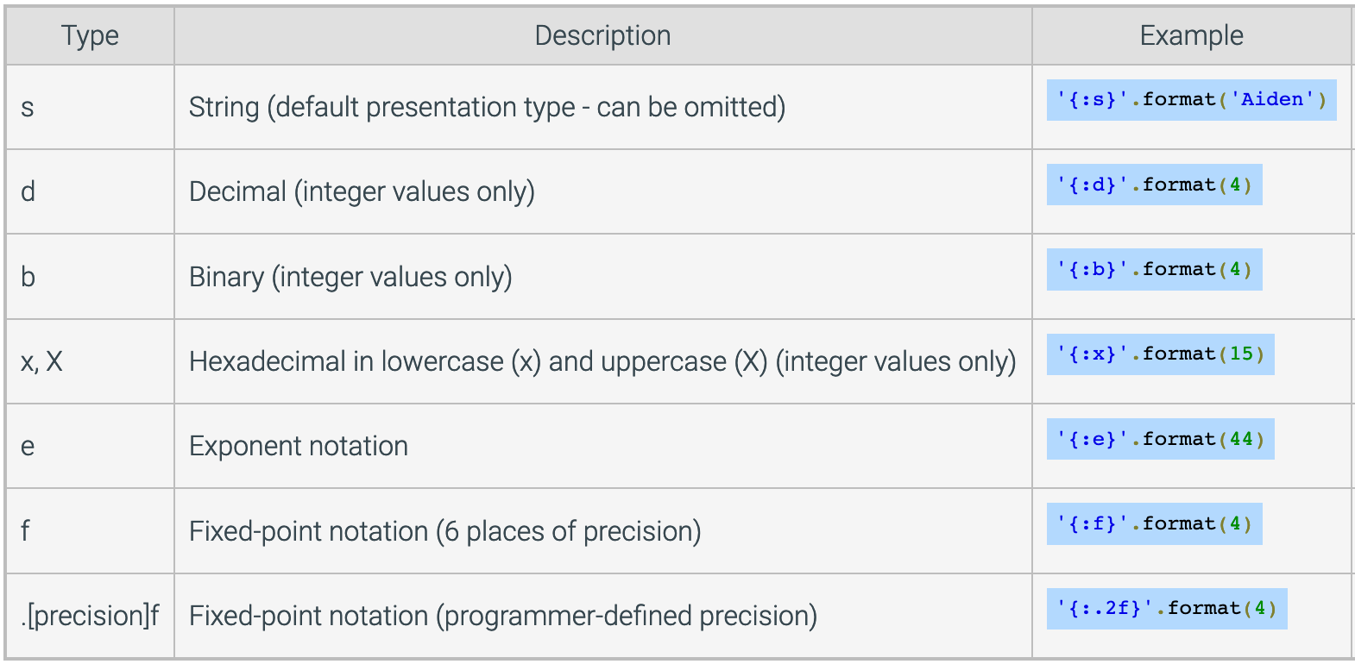
Format Specifications
A format specification inside a replacement field allows a value’s formatting in the string to be customized
Use a colon : followed by the format specification for the desired presentation type

Slide 43
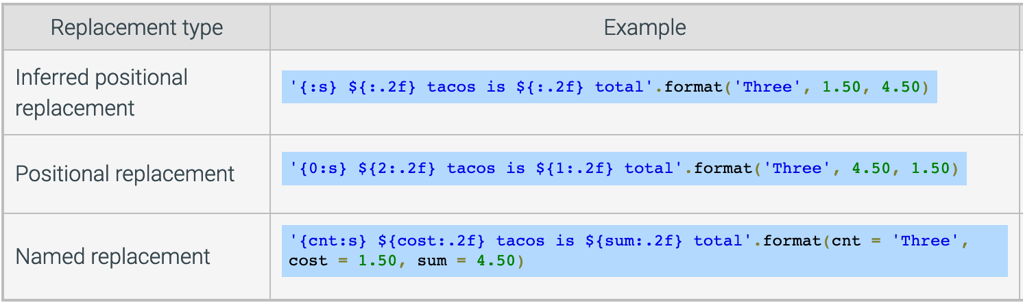
Format Values in Replacement Fields
The colon : separates the "what" on the left from the "how" on the right
The right "how" side determines how to show the value

